Slide 1

Improve query performance with dual storage mode tables
BY NITIN

Slide 2
OBJECTIVE
I understood how to optimize an enterprise scale tabular model.
I learned about how to set up the dual storage model.

Slide 3
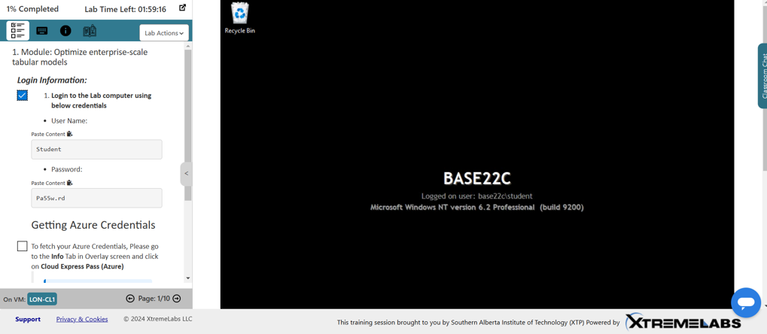

Slide 4
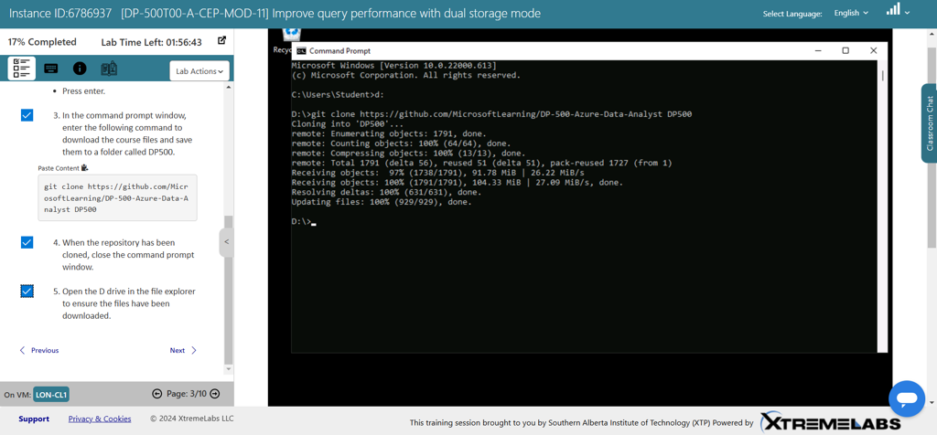

Slide 5
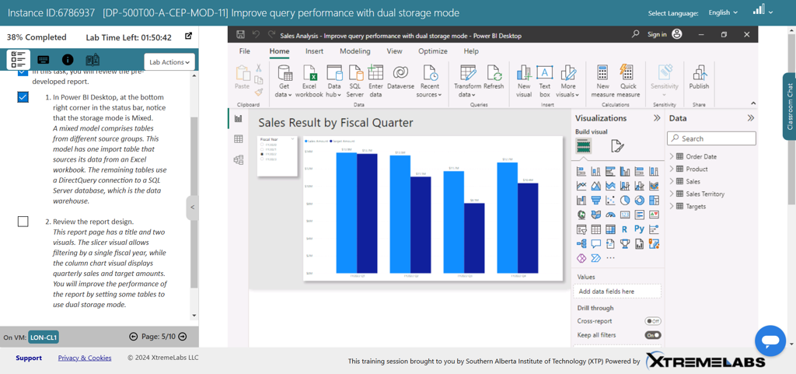

Slide 6
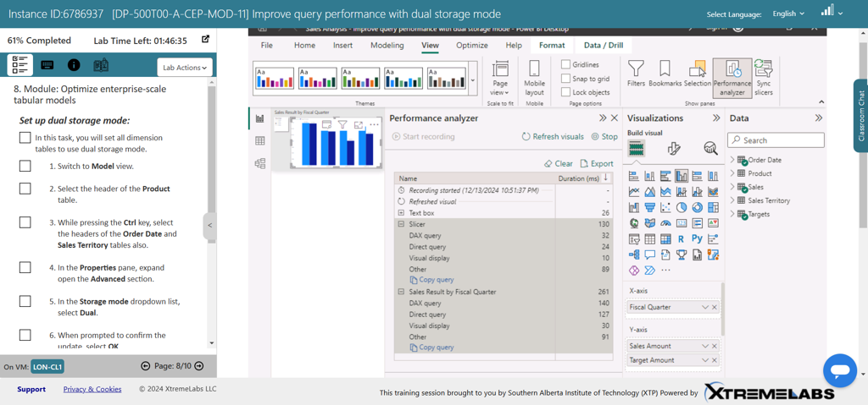

Slide 7
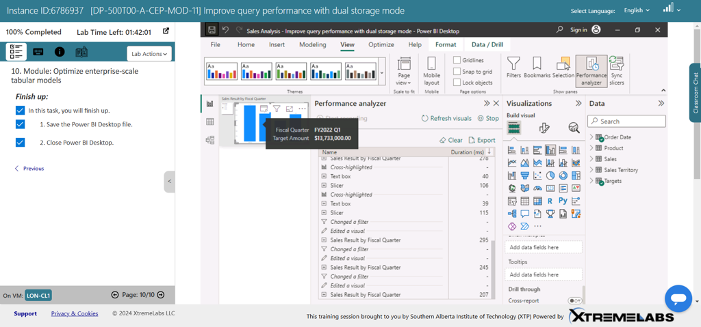

Slide 8
